Slide 1
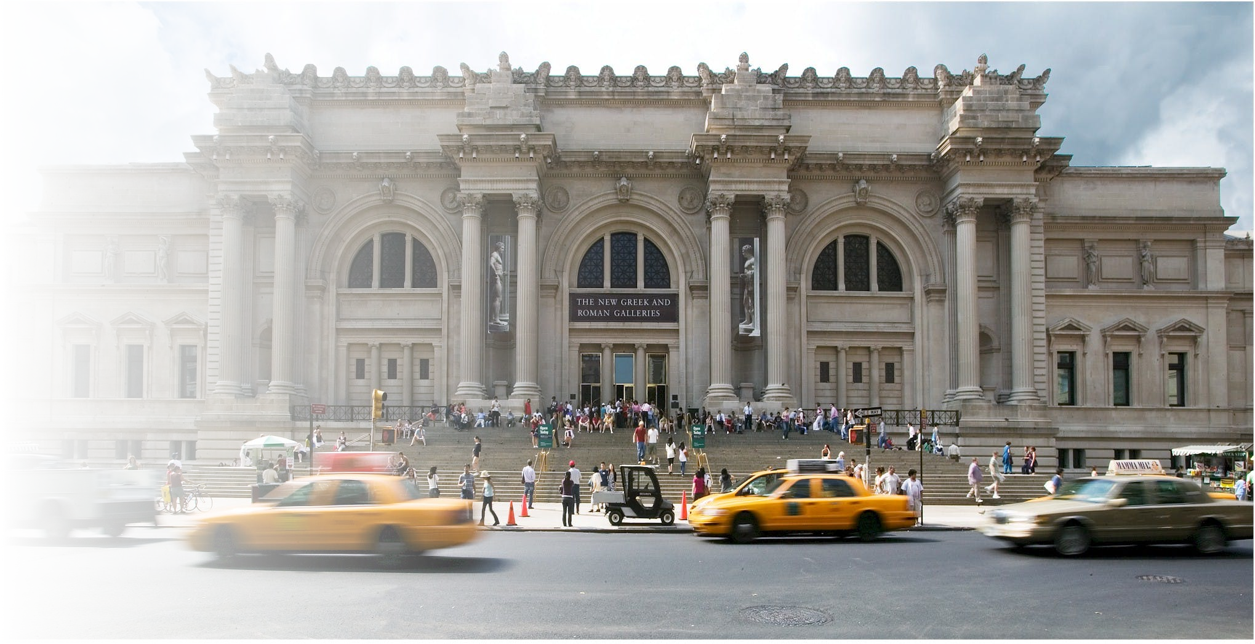
A Data Scientist’s Investigation of Art at The Met
Liam Fruzyna
Notes:
Wanted to be able to get more in depth with this but there was just too much data to have fun with

Slide 2



My Tools
Python with Pandas for data processing and input
Matplotlib, Plotly, and Seaborn for Graphing and Plots
Re for Title and Date Processing
Numpy for some Stats
Notes:
Just tools, means nothing to the class, glance over

Slide 3
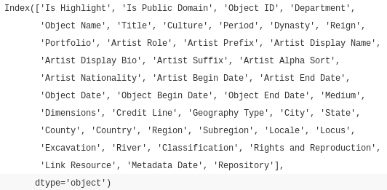
Open Access at The Met
Since 2017 all public works are Creative Common Zero
Database of all works is provided
Over 460k pieces
Information such as:
Department
Medium
Title
Artist
Dates
Locations
Notes:
234mb of text (smallest data set for this semester)
Department isn’t very helpful in this case
Dates are a complete mess
Locations are very incomplete
Most used is title, object date, and credit line

Slide 4
Location Data is Awful
Percent Missing Data
City – 93%
State – 99%
County - 98%
Country – 84%
Region – 93%
Subregion – 95%
Locale – 97%
Locus – 98%
Excavation – 97%
River - >99%
Notes:
My original plan was to look at the movement of Christianity over time through art
Most is far to old to get anything specific
Some is America specific
But even where it was found is next to none
This is with all art

Slide 5
Determining Which Art is Christian
No blatant label
Most informative piece is Title
Chose a list of words that would only be used in Christian art
'christ', 'heaven', 'the lord', 'crucifixion', 'good shepherd', 'satan', 'saint', 'ascension', 'lamentation', 'epiphany', 'madonna', 'resurrection', 'mother mary', 'the cross', 'apostle', 'last judgement', 'final judgement', 'last supper', 'magi', 'annunciation', 'virgin', 'jesus'
Not perfect but good enough
Notes:
The most or second most (to dates) intensive process here
Scan through all 460k + titles and see if any of these words exist

Slide 6
Overview of Christian Art at the Met
All Art
Christian Art
460,258 Pieces
Peaks in 19th Century
18,706 Donors
8.2% Purchased
56,522 Artists
13507 Kinds of Art
10,288 Pieces
Peaks in 16th Century
996 Donors
11.8% Purchased
3,413 Artists
332 Kinds of Art
Notes:
Just some summary statistics
Christian art is a small part

Slide 7
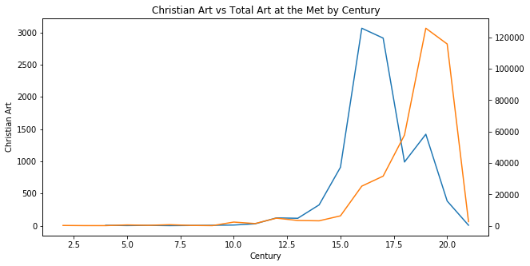
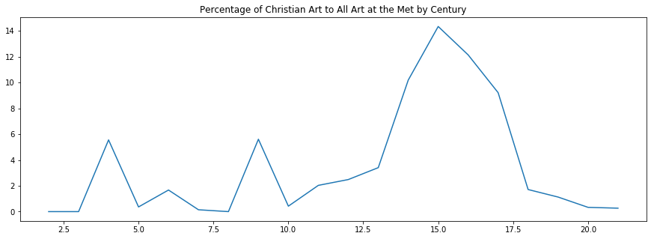
When was this art from?
Notes:
Interestingly Christian art peaks 3 centuries before the total collection does (16th vs 19th)
However it is the highest percentage during the 15th century

Slide 8
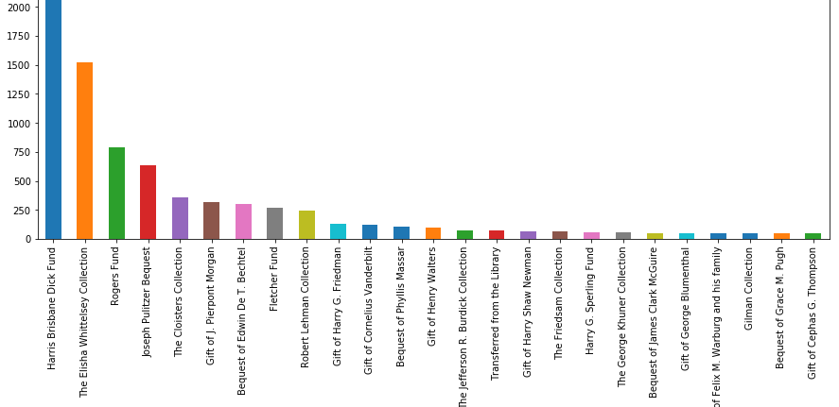
Who was donating this art?
Notes:
970 total Christian donors
HBD has about 1/5 of all Christian art

Slide 9
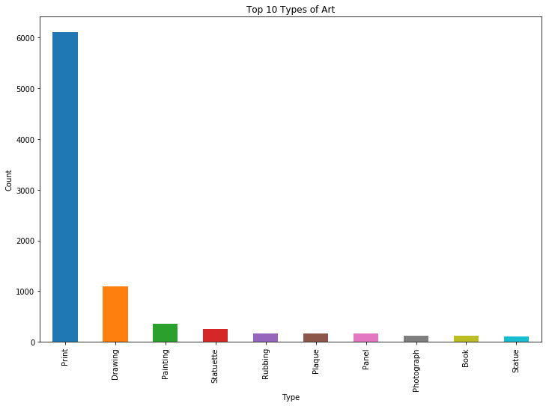
What Kind of Art Was This?
Notes:
Top 10 all over 100 total
Mostly prints and drawings
Prints are mass produced and drawings are done several times before a final
Normal art has a lot more but more artifacts in that kind
Word choice limits options in a way

Slide 10
Analysis of Scenes by Century and Donation Year
Plus samples of what I have found in the data

Slide 11
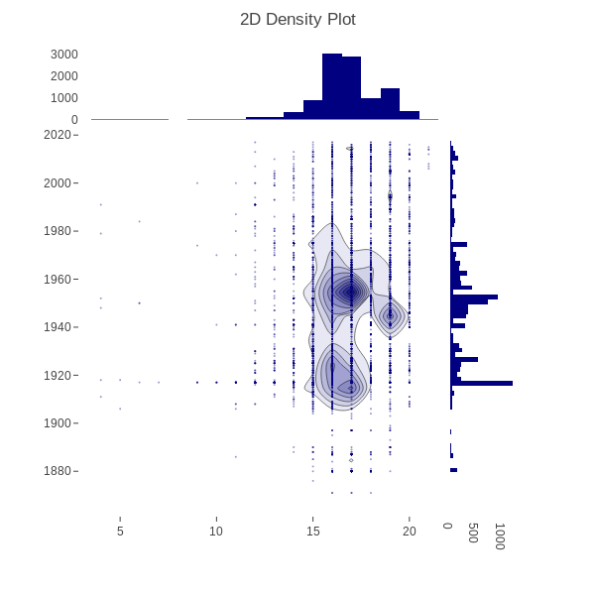
All Christian Art
Most art is from 16th and 17th centuries
Most commonly donated around 1950
Likely do to recovery of art after WWII
Next most from 1920 – 30
More post war recovery
Roaring 20s
Great Depression was actually good for art
Notes:
Explain the 2D density plot
Scatter plot of donation year on the y and century on the x
With a heat map on top and histograms along the axis to show frequency and distribution
Great depression generated more governmental art funding, see 19th century peak around 1940
A large philanthropic movement then also
Lots of 19th century donations in 40s
Later see Pulitzer and Morgans donations in 1917

Slide 12
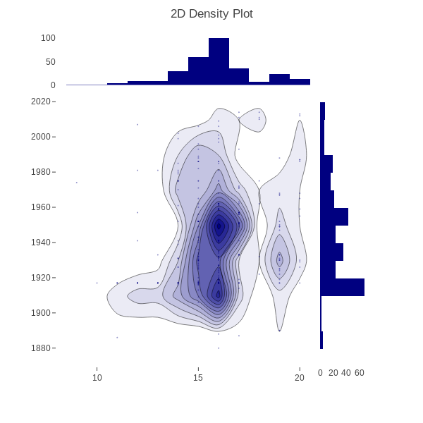
Crucifixion
292 Examples
Similar distribution to all Christian art
Notes:
Weird bump in donations around 1917, let’s investigate that

Slide 13
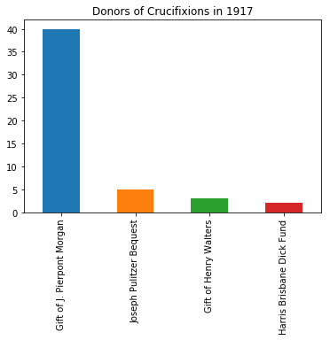
Crucifixion
292 Examples
Similar distribution to all Christian art
Notes:
Ah JP Morgan
Roughly 8 times more than the next guy (who is the 4th most total, his Pulitzer Prize came the same year)
Only 247 total pieces that year, ~16% where as Crucifixion are ~3%

Slide 14
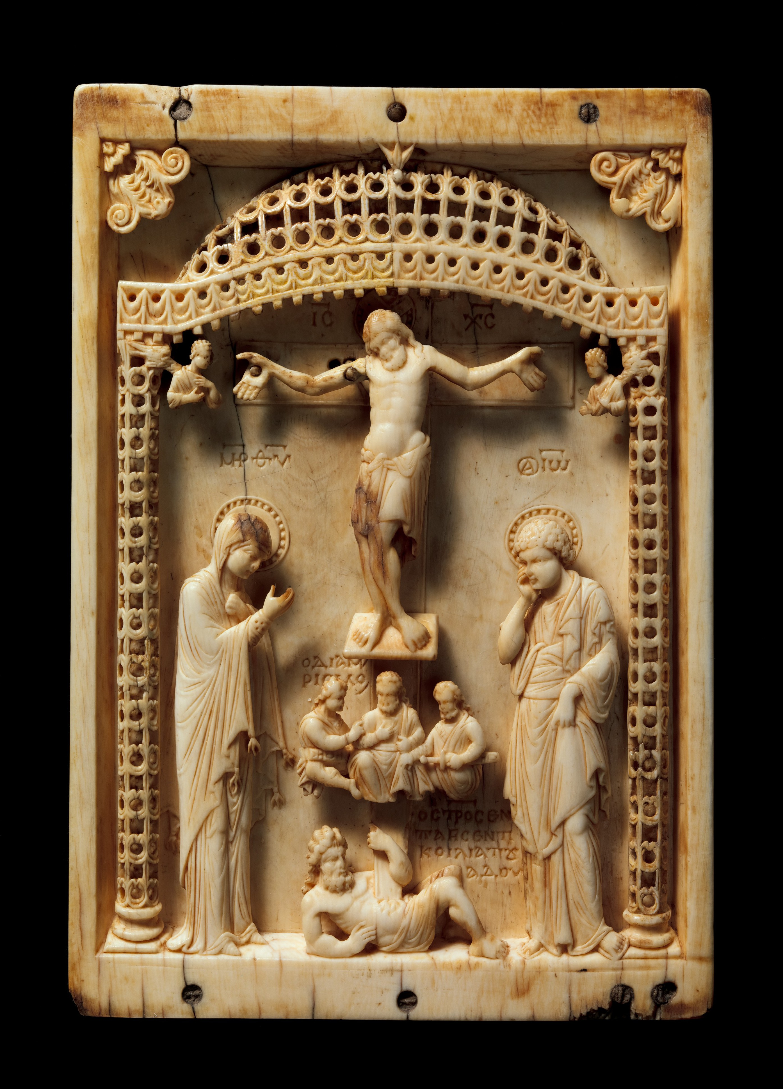
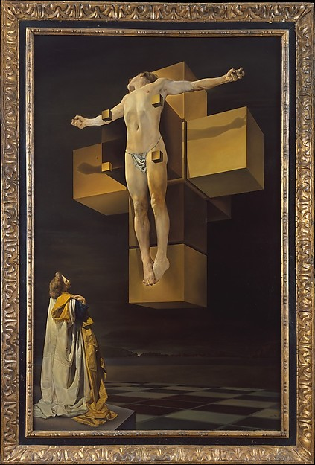
Crucifixion
Mid 10th Century Icon
Donated by JP Morgan
1954 Salvador Dali
Donated by Chester Dale
Notes:
Dali donated the next year, Contemporary
Mary and John below with the 3 soldiers dividing the garment
Man under cross stabbed in unique to byzantine art, it is hades
weapon of Christ's crucifixion killing death
Weak vs strong and healthy
A reminder vs dreamlike
Education vs meaning, evolution of art

Slide 15
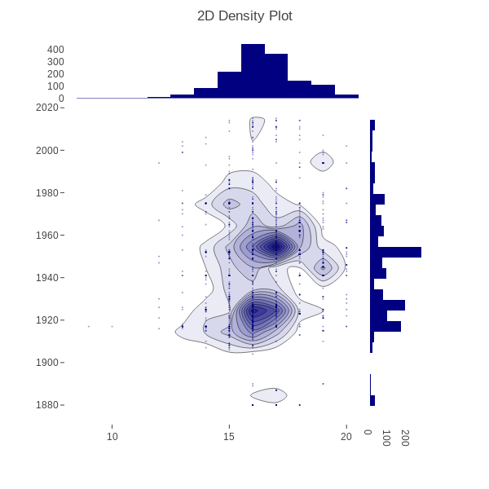
Madonna and Child
1462 Examples
Very similar distribution to all Christian art
Most common single scene
Notes:
Very similar likely because it is a 10% sample of the population

Slide 16
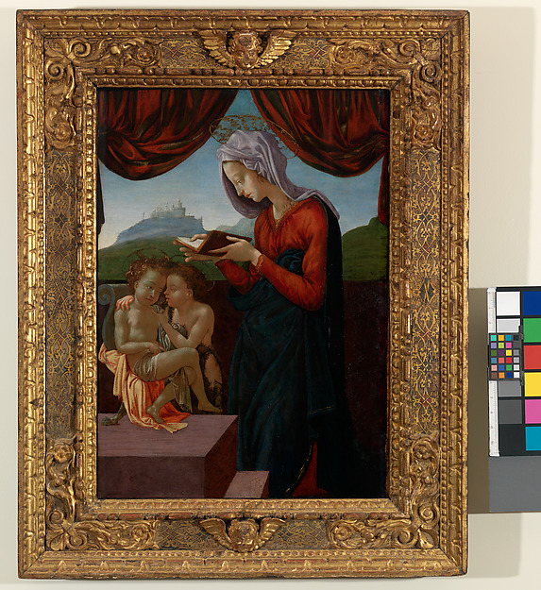
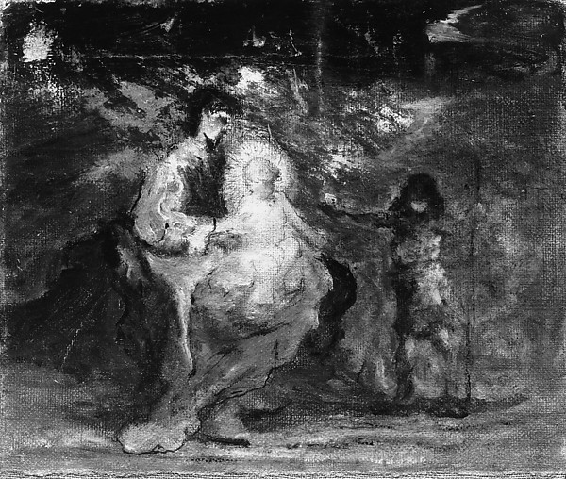
Madonna and Child
Madonna and Child w/ Infant St John
Michelangelo ~1500
Madonna and Child w/ Little St John
Robert Loftin Newman 1894
Notes:
Italian Renaissance, Modern Impressionism
Left: technically not Michelangelo but his inner circle
Right: St John is dressed in camel’s hair (as described in the Gospel) offering Christ an apple (salvation)
More secular meaning
Suffered a harsh cleaning
Overall detail suffers for emotion

Slide 17
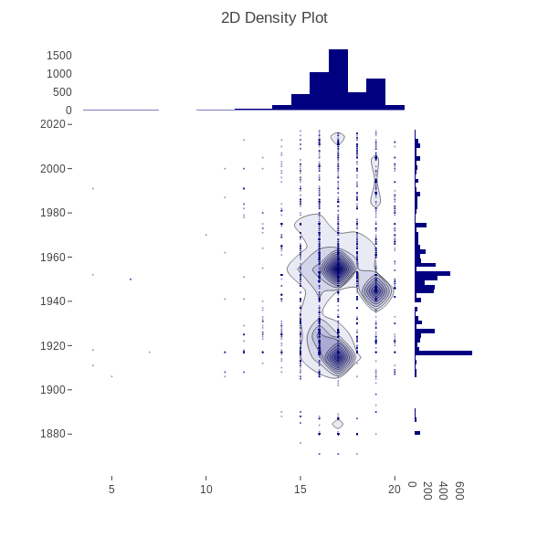
Saints
4908 Examples
Most common keyword
Significantly high percentage of 17th century works
All others peak in 16th
Notes:
Despite almost being half the total population it is significantly different

Slide 18
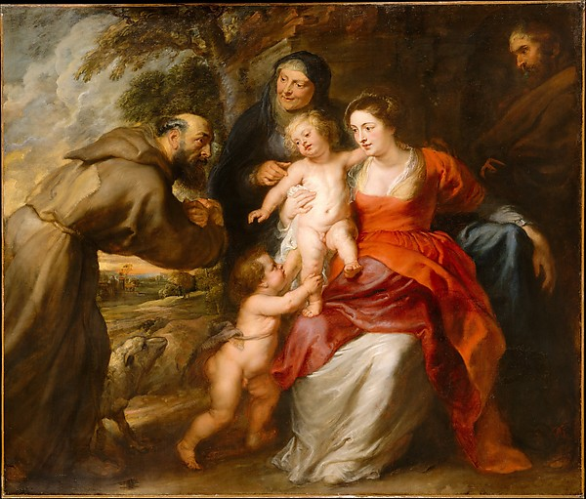
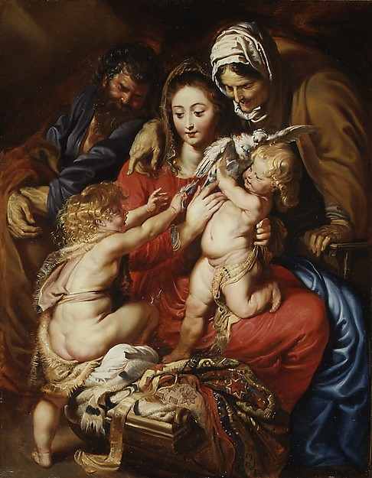
Peter Paul Rubens in the 17th Century
The Holy Family w/ Saint Francis and Anne and the Infant Saint John the Baptist
The Holy Family w/ Saint Elizabeth, Saint John, and a Dove
Notes:
Flemish Baroque
Catholic
Left is first to enter an American public collection
Can see the improvement on his art as the right is about 20 years older (1608-9 and mid 1630s)
-much more color
In both pictures Joseph seems to be in the shadow as if an afterthought
both John is trying to get at Jesus

Slide 19
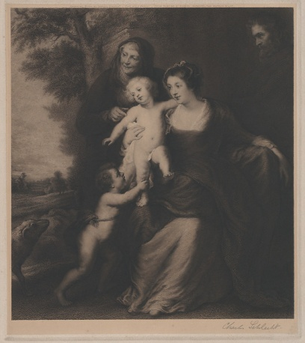
Charles Schlecht - 1916 - Engraving
The Holy Family w/ Saint Francis and Anne and the Infant Saint John the Baptist
The Holy Family w/ Saint Anne and the Infant Saint John the Baptist
Notes:
Left St. Francis out
Could have been a size limitation
Takes up most of left side and it’s a square piece
Was an engraver for the Bureau of Engraving and Printing in NYC and DC
Don’t know much else about him

Slide 20
More Info and References
More Info and Further Research
References
Github.com/mail929/MU-THEO2310H
Further expansion
Change of material over time
Why did Christian art peak before all
Open Access at The Met
Metmuseum.org/about-the-met/policies-and-documents/open-access
Github.com/metmuseum/openaccess

